Slide 1
Networks and CBS
Javier Garcia-Bernardo
ODISSEI Social Data Science group
Utrecht University

Slide 2
Tabular data
 | child_post2020 | Age | Income | …
Person 1 | 1 | 30 | 50000
Person 2 | 0 | 25 | 30000
Person 3 | 1 | 32 | 40000
Person 4 | 0 | 40 | 25000
Person 5 | 0 | 28 | 100000
Notes:
We covnert text to tabular data

Slide 3
Relational data (networks)
Our life is completely defined by networks: relationships, interactions, communications. Biological networks governing the interactions between genes in our cells determine our development, neural networks in our brain make us think, information networks guide our knowledge and culture, transportation networks allow us to move, and social networks sustain our life.
A First Course in Network Science, F Menczer, S Fortunato, C.A. Davis

Slide 4
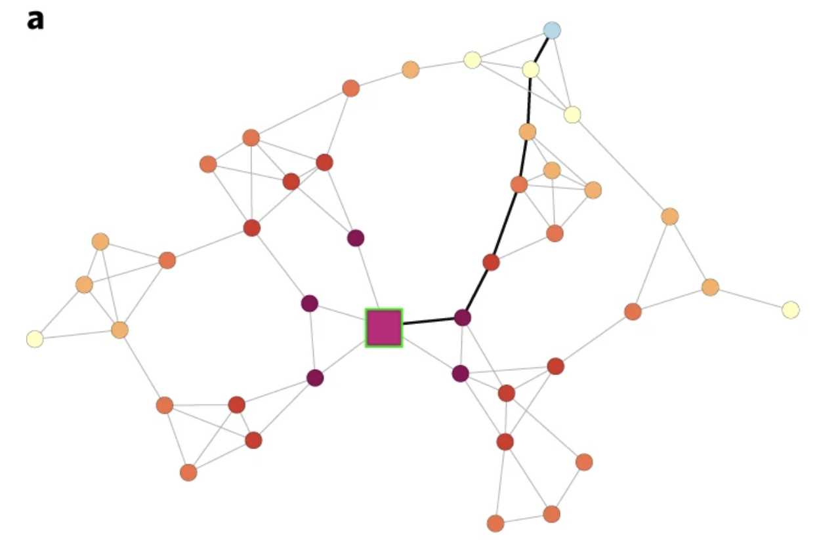
Relational data (networks)
 | X₁ ? | X₂ ? | … | X_{N} ?
Person 1
Person 2
Person 3
Person 4
Person 5
If we were to study networks using tables, how do we include connections?
Create individual-level variables
Deep-learning: create “person embeddings”
Notes:
We covnert text to tabular data

Slide 5
Why do we care about the connections?
Notes:
We covnert text to tabular data

Slide 6
1) They reflect underlying patterns (e.g. differences in power/preferences/roles/groups).
Network of countries trading with each other: Which country has the most bargaining power?
Network of connections between politicians and companies: Who is the most politically influential company? Who is corrupt?
Network of email communication within a company: What type of roles do employees of a company play (coordination/innovation/etc)?
Network of online media referencing each other: What is the political ideology of media outlets?
Notes:
We covnert text to tabular data

Slide 7
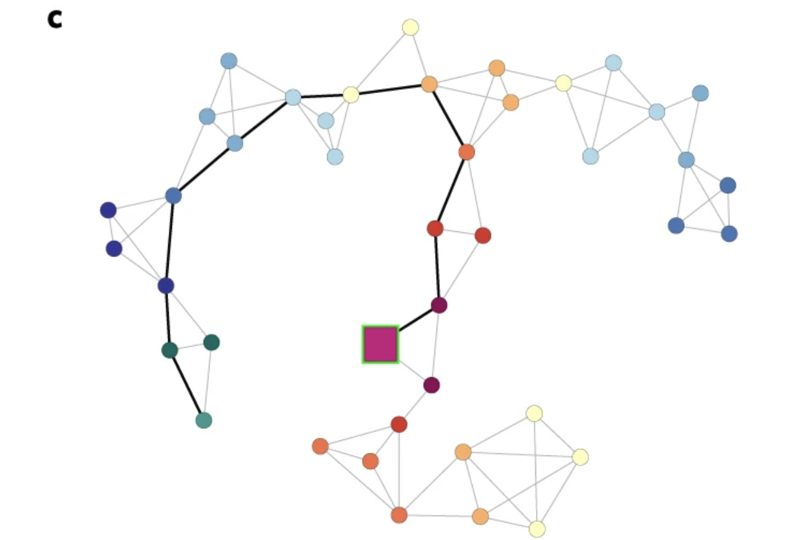

2) They constrain/facilitate future change.
Which person would you vaccinate first?
Networks allow us to understand dynamics: epidemics, contagion, development
Block, P., Hoffman, M., Raabe, I. J., Dowd, J. B., Rahal, C., Kashyap, R., & Mills, M. C. (2020). Social network-based distancing strategies to flatten the COVID-19 curve in a post-lockdown world. Nature human behaviour, 4(6), 588-596.
Notes:
We covnert text to tabular data

Slide 8
2) They constrain/facilitate future change.
Which person will become a parent next?
Block, P., Hoffman, M., Raabe, I. J., Dowd, J. B., Rahal, C., Kashyap, R., & Mills, M. C. (2020). Social network-based distancing strategies to flatten the COVID-19 curve in a post-lockdown world. Nature human behaviour, 4(6), 588-596.
Notes:
We covnert text to tabular data

Slide 9
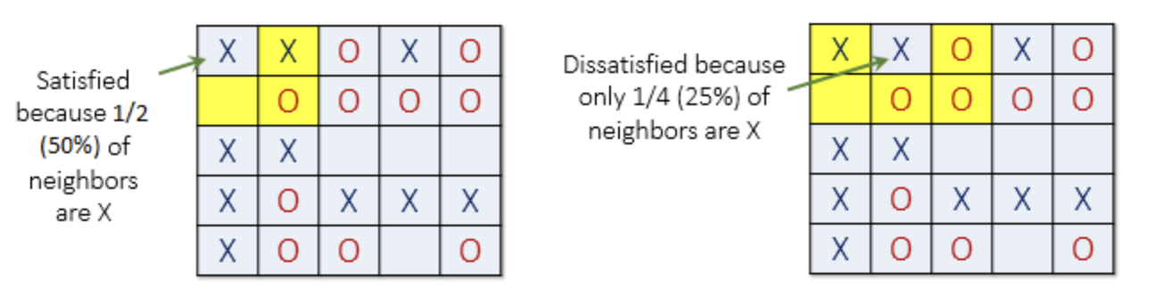
3) Interactions can create emergence
Sometimes a system (e.g. a society) has properties that the individual parts do not have. These properties are called “emergent” properties, and the system a complex system.
“There's no love in a carbon atom, no hurricane in a water molecule,
no financial collapse in a dollar bill.” Peter Sheridan Dodds
In social science: Connect micro-behavior to macro outcomes
e.g. Schelling model: why do we see urban segregation?
Every actor lives in a house and is connected to its neighbors in a network. Every actor is the same:
They want to have 1/3 of their neighbors to be like them
Otherwise, they move to a random house
http://nifty.stanford.edu/2014/mccown-schelling-model-segregation/
Notes:
We covnert text to tabular data

Slide 10
Examples of research questions that can be answered with networks
Epidemiology: How to stop disease transmission in a social network?
Criminology: How to detect criminal actors in a network of money flows?
Biotechnology: Which genes to target to stop cancer in a gene regulatory network?
Ecology: Which animals we need to preserve to avoid ecosystem collapse?
Psychology: In a within-person attitude network, how does attitude change depend on the correlation between other attitudes?
Engineering: How to improve network performance and reliability in power grids?
Economics: How does country development depend on the type of products a country export?
Social science: How does social capital affect upward mobility?
Physics view: Dependence on topology (reliability, dynamics, emergent behavior and phase transitions)

Slide 11
Today
Introduction to Networks
Networks at CBS and the netCBS package

Slide 12
Introduction to networks

Slide 13
What is a network?
Mathematical representation of the relationships (edges) between entities (nodes)
The most important question to ask yourself is
What are the nodes and what are the edges?
Notes:
You can think of many things as a newtork. Social networks….

Slide 14
Types of networks
Network | Nodes | Edges
Friendship | People | Friendships
Instagram | Online accounts | Followers/likes
Psychological | Attitudes or behaviors | Co-ocurrence
Gene regulatory | Genes | Activations/inhibations
Food web | Animals | Predation
Trade | Countries/companies | Money flows
Ownership | Companies | Ownership stakes
Internet | Computers (IPs) | Data transmission
Power grid | Power stations | Power lines
Airplane network | Airports | Flights
Social/
Behavioral
Biology
Economic
Intrastructure
Adapted from: https://aaronclauset.github.io/courses/5352/csci5352_F21_L1.pdf
Notes:
Networks are present in all aspects

Slide 15
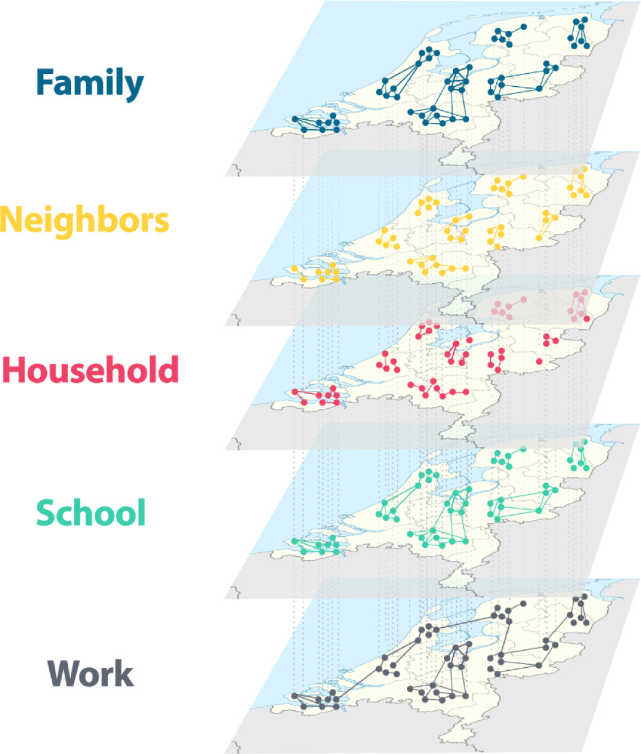
Type of networks and characteristics
Type 1: Interaction and flow → “Real networks”.
Offline interactions
Online interactions
Type 2: Affiliation → Node 1 is part of/related to node 2
Bipartite networks, e.g. students in classrooms
Type 3: Co-occurrence → Node 1 is correlated with node 2
e.g., stock market networks (two stocks correlate)
e.g., brain networks (the brain signals in two areas correlate)
Today we focus on the first type (“real networks”)
Kazmina et al, 2024

Slide 16
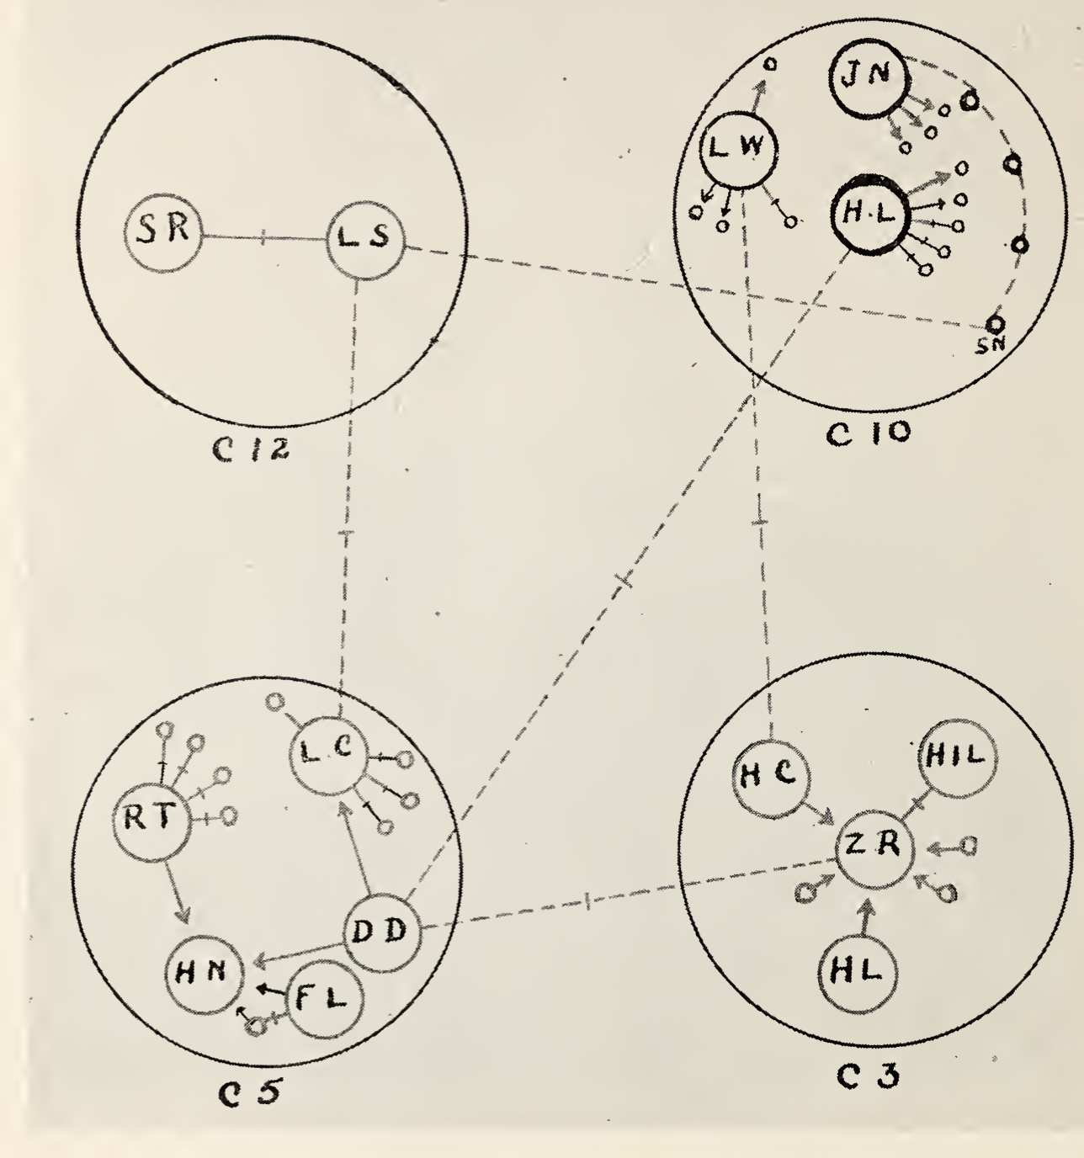
Brief history of social network science:
Mathematical representation of an underlying system (not the system itself)
Network science: Social and behavioral scientists in the XX century (e.g. Jacob Moreno & Hellen Hall Jennings, Harrison White, Mark Granovetter)
Hellen Hall Jennings and Jacob Moreno (1930s): Hudson School for girls: Sociometry. Networks can represent the systems and how information spreads
Jeffrey Travers and Stanley Milgram’s (1969): Small-world studies
Nancy Howell (1969): The Search for an Abortionist, women acquired scarce information through short chains of weak ties.
Mark Granovetter (1973) The Strength of Weak Ties. Diffusion of information takes place primarily through bridges (weak ties). Strong links are redundant.
Harrison White (1976): Blockmodels for networks
Duncan Watts, Steven Strogatz (1998): Next wave of network science
Moreno. Who shall survive?

Slide 17
Basic definitions

Slide 18
Networks (graphs)
Nodes (vertices, actors) connected by
edges (links, connections, relationships)
N: Nodes = {Alice, Bob, John, Amy}
E: Edges = {(Alice, Bob), (Alice, John), (John, Amy)}
The edge (i,j) connects node i to node j
Nodes can have attributes (e.g. gender, income, etc)
Edges can have attributes (e.g. type, strength, etc)
Bob
(100)
Alice
(100)
John
(20)
Amy
(10)

Slide 19
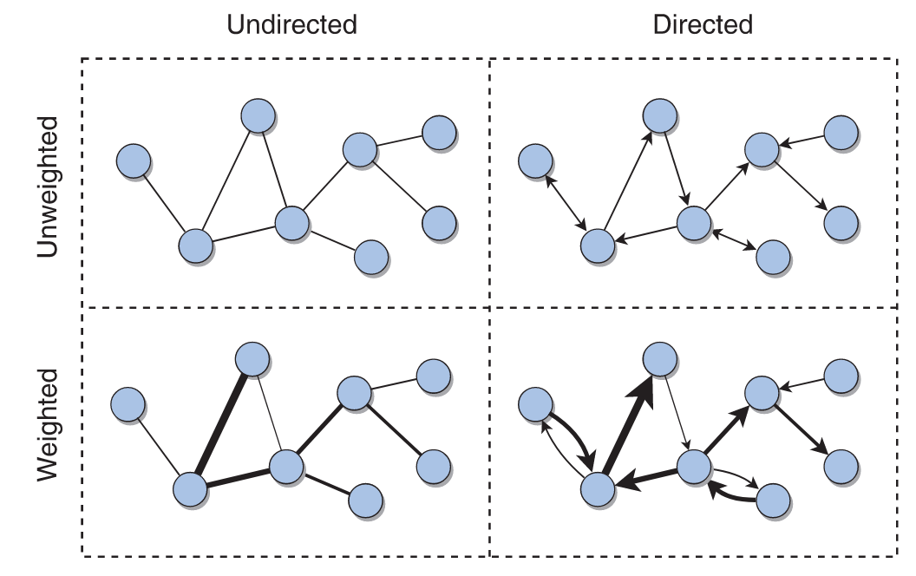
Directed vs undirected; weighted vs unweighted
Undirected: The link (i,j) connects node i to node j in both directions
Directed: The link (i,j) connects node i (source) to node j (target)
Weighted: There is a weight associated to each edge
Source: A first course in network science (2020)

Slide 20
Degree in undirected networks
Degree of a node: Number of neighbors
Node: degree
Alice: 2
Bob: 1
John: 2
Amy: 1
Bob
(100)
Alice
(100)
John
(20)
Amy
(10)

Slide 21
Degree in directed networks
Out-degree: Number of outgoing edges
In-degree: Number of incoming edges
Total degree: Sum of out and in degree
Node: (out, in, total)
Alice: (2, 0, 2)
Bob: (0,1, 1)
John: (0,2, 2)
Amy: (1,0, 1)
Bob
(100)
Alice
(100)
John
(20)
Amy
(10)

Slide 22
Other types of networks: Multiplex
Bob
Alice
John
Amy
Bob
Alice
John
Amy

Slide 23
Other types of networks: Signed
Structural balance
Bob
(100)
-1
Alice
(100)
John
(20)
+1
-1
Amy
(10)

Slide 24
Other types of networks: Temporal
Either:
Snapshots
Time of events
Bob
Alice
John
Amy
Time = 1
Bob
Alice
John
Amy
Time = 2

Slide 25
Other types of networks: Bipartite
Alice
(100)
Bob
Alice
Project
John
Bob
(100)
School 1
Amy
John
(20)
School 2
Project
School 1
School 2
Amy
(10)
Unipartite projections
Bipartite

Slide 26
Other types of networks: Multipartite
Bob
Alice
Bob
(100)
John
Amy
Work 1
Alice
(100)
School 1
Project
Bob
John
(20)
Alice
Work 2
John
School 2
Amy
(10)
Amy
Multipartite network
Multiplex projection

Slide 27
Other types of networks: Ego-networks
Bob
(100)
Alice
(100)
John
(20)
Ego network of Alice at depth 1
Bob
(100)
Alice
(100)
John
(20)
Bob
(100)
Amy
(10)
Alice
(100)
Mei
(1)
John
(20)
Amy
(10)
Ego network of Alice at depth 2

Slide 28
Network representation
Bob
Alice
John
Adjacency list (edgelist):
Adv: It is dense: Only keeping edges
Disadvantage: Hard to work with
Adjacency matrix:
Adv: Math is easy (matrix multiplication)
Disadvantage: It is sparse (mostly zeros). 1 million nodes → 1 trillion numbers
Origin | Target | Weigth
Alice | Bob | 1
Alice | John | 1
Target → ↓ Source | Alice | Bob | John
Alice | 0 | 1 | 1
Bob | 0 | 0 | 0
John | 0 | 0 | 0
In computer → Sparse matrices: Best of both worlds

Slide 29
Network metrics and characteristics

Slide 30
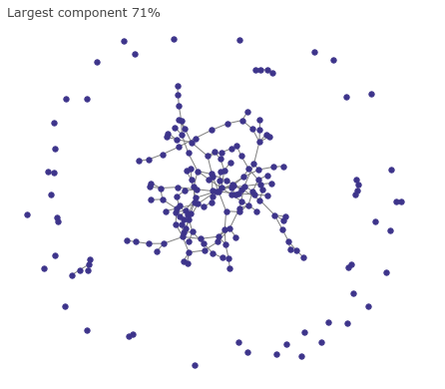
Connectedness
Real networks are typically connected, forming a “giant component”
If the average degree < 1 → many small components
If the average degree > 1 → suddenly the system becomes connected

Slide 31
Density
Bob
Definition: Number of edges present / potential number of edges
Density = 3/6 = 50%
Larger networks are usually sparser
Everybody on earth has 200 friends: edges = 200*8e12 = 1.6e15
Possible ties: (8e12 ^ 2)/2 = 3.2e25
Density = 1.6e16 / 3.2e25 = 0.00000005%
Alice
John
Amy

Slide 32
Clustering coefficient (~transitivity)
Local clustering (from the point of view of each node):
Amongst all possible pairs of friends, how many are friends with each other?
The share of triads (connected sets of 3 nodes) that are closed (form a triangle)
Real networks have high clustering
Clustering of Alice:
Bob
Bob
Bob
Bob
Alice
Alice
Alice
Alice
John
John
John
John
Amy
Amy
Amy
Amy
0/3
1/3
2/3
3/3

Slide 33
Reciprocity
Directed networks
Ratio of the number of edges pointing in both directions to the total number of edges in the graph.
Bob
Bob
Alice
Alice
John
John

Slide 34
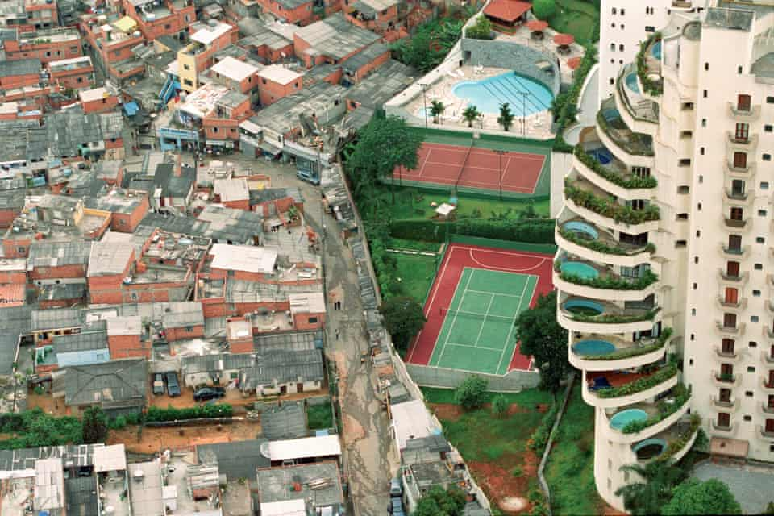
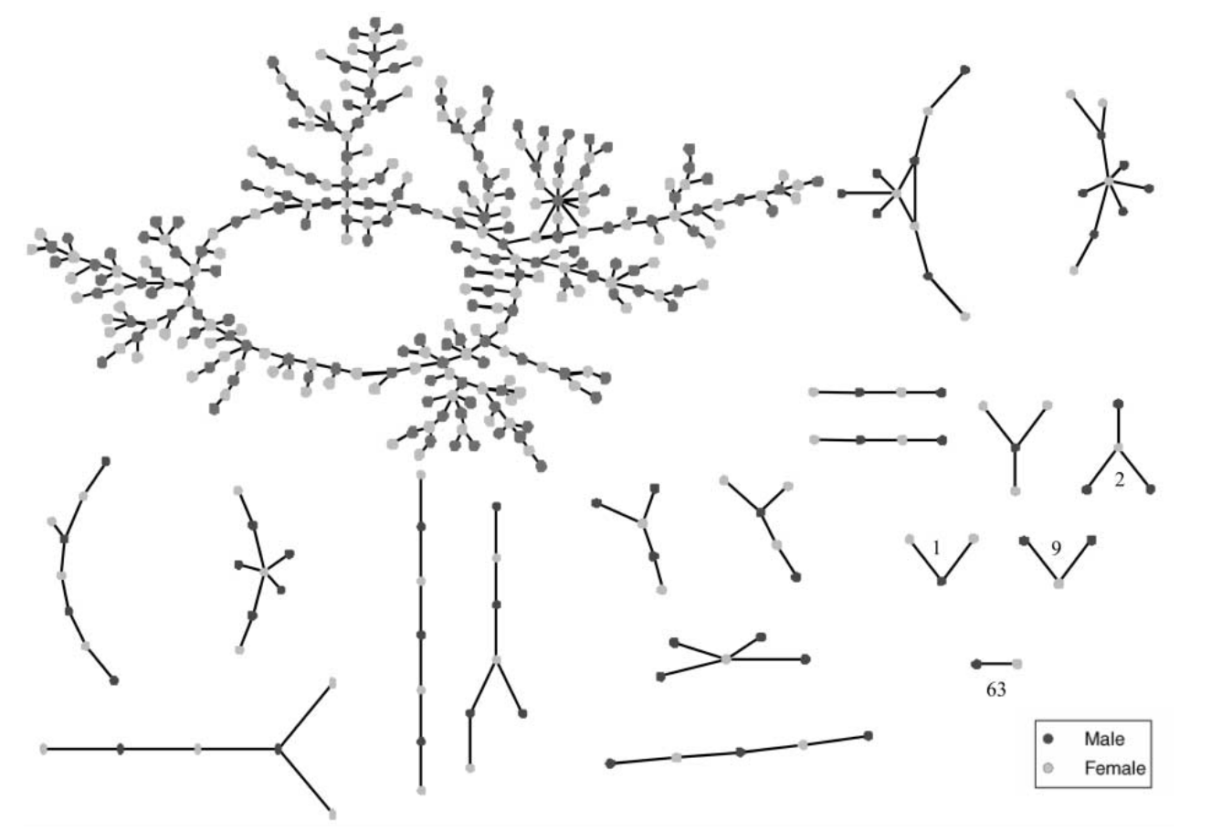
Assortativity (homophily)
Preference for nodes to attach to others that are similar in some way
Defined with respect of an attribute (e.g. gender)
Ranges from -1 (fully disassortative) to 1 (fully assortative)
Paraisópolis favela and Morumbi, in São Paulo
Photography by Tuca Vieira (the guardian)
Romantic links between teenagers
Bearman, Moody, Stovel (1991)

Slide 35
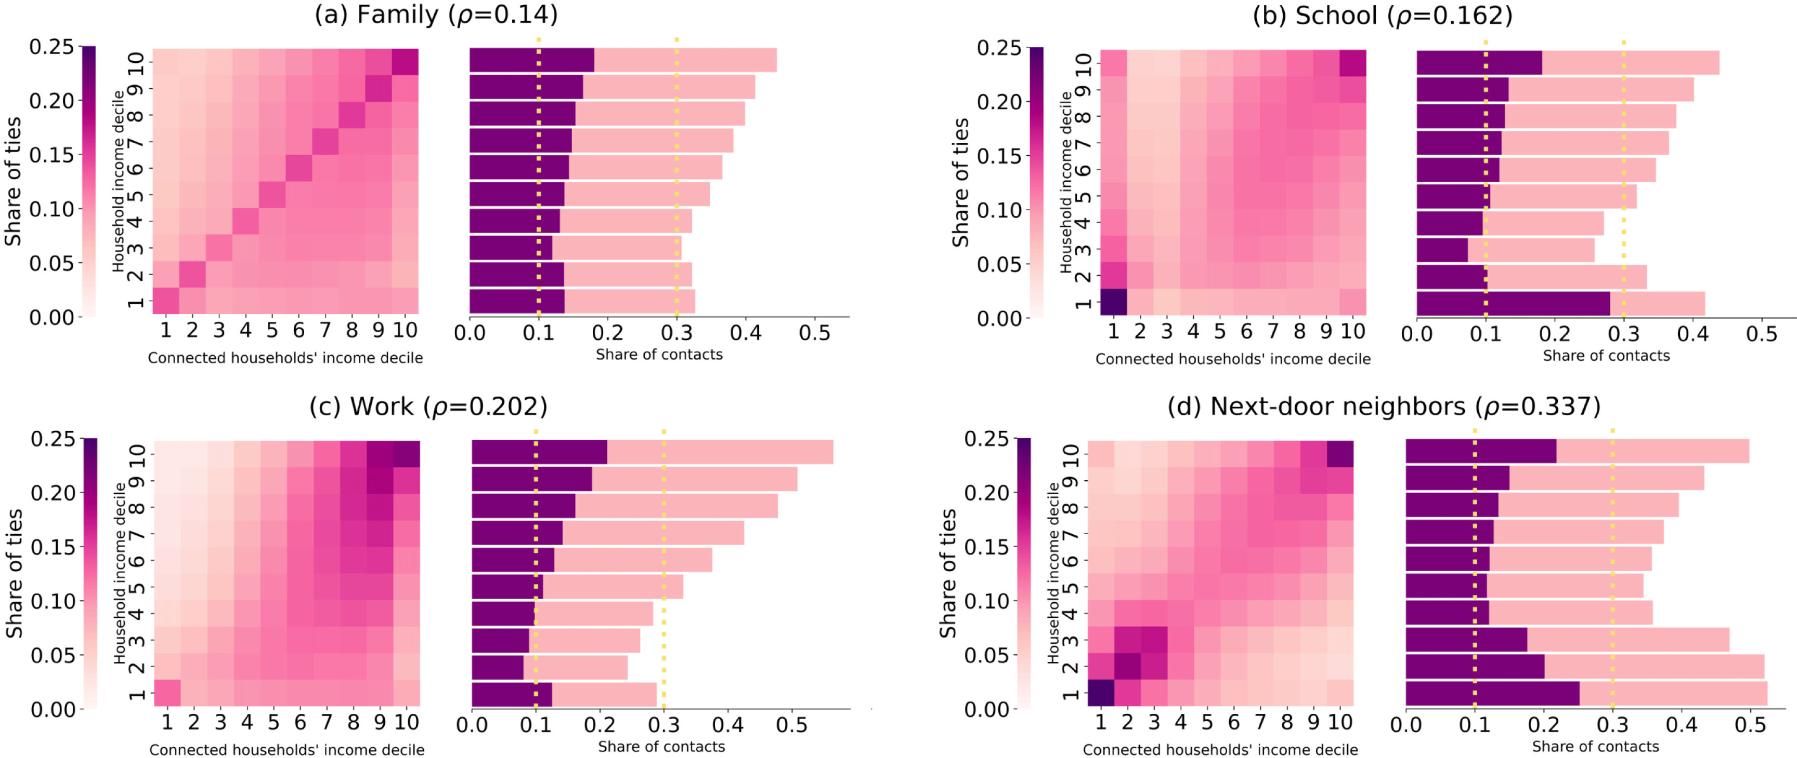
Assortativity in CBS
Socio-economic segregation in a population-scale social network, Kazmina, EM Heemskerk, E Bokányi, FW Takes
Social Networks 78, 279-291

Slide 36
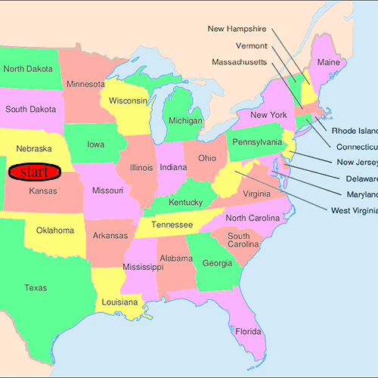
Small world: six degrees of separation
Shortest path between node 1 and node 2:
Minimum number of steps requires to go from node 1 to node 2
Between Alice, Amy → 2
Diameter:
Longest “shortest path” between two nodes
In our network: 2 (Alice -> John -> Amy)
Real networks have small diameters because hubs connect diverse parts of the network
Bob
Alice
Milgram’s experiment (1967)
Image source: Drewonwiki, Wikipedia
John
Amy

Slide 37
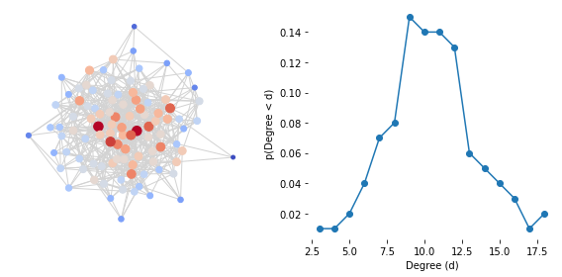
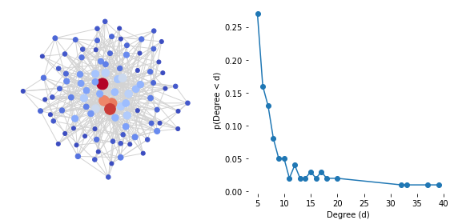
Skewed degree distributions
Random network
Realistic network
Notes:
Connections are not random
A few removals → cascading effects
Albert, Jeong, Barabasi (2000) Attack and error tolerance of complex networks

Slide 38
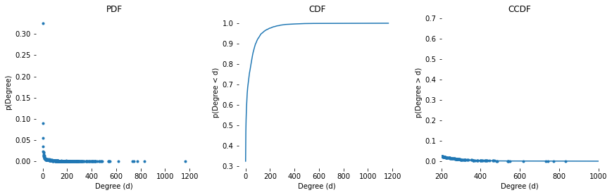
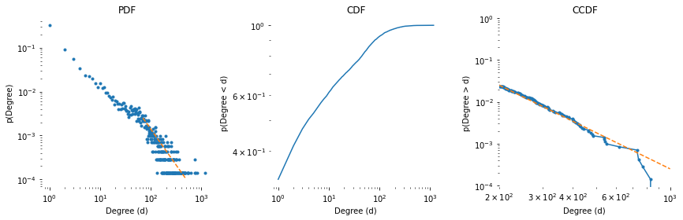
Real network (Wikipedia mentions)

Slide 39
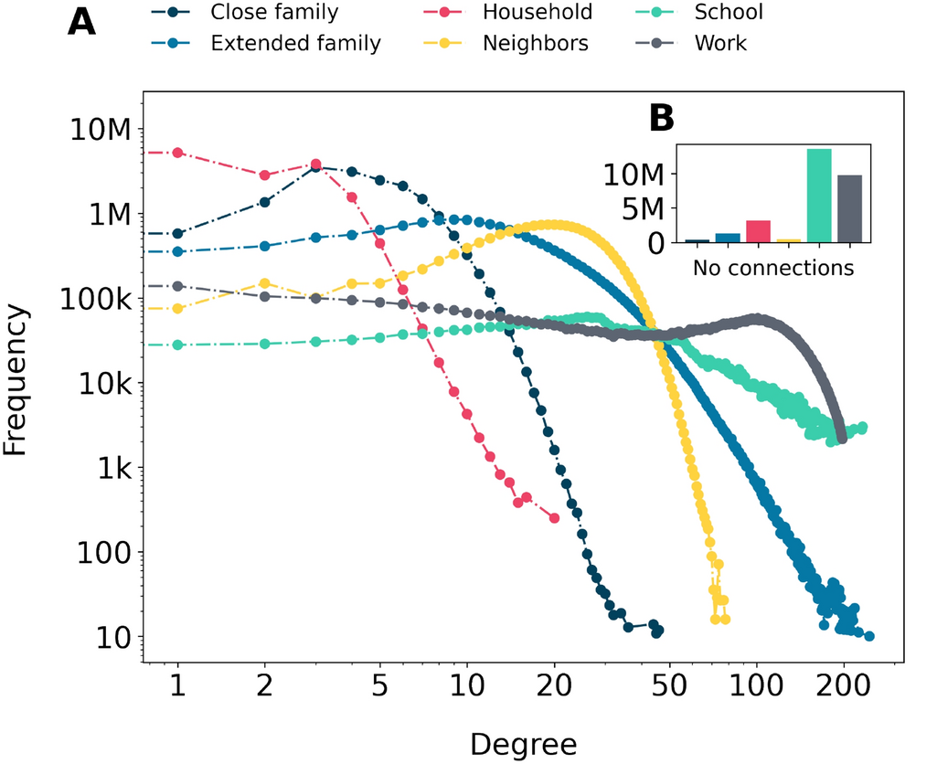
Careful: The data is a bit different now!
Especially the neighbors
The anatomy of a population-scale social network, E Bokányi, EM Heemskerk, FW Takes
Scientific Reports 13 (1), 9209

Slide 40
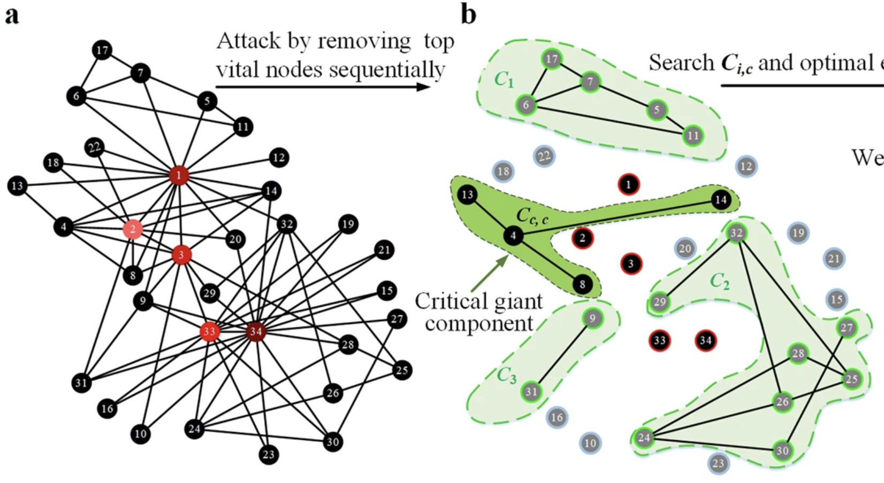
Robustness to failures Fragility to targeted attacks
Albert, Jeong, Barabasi (2000) Attack and error tolerance of complex networks
Li et al (2011)

Slide 41
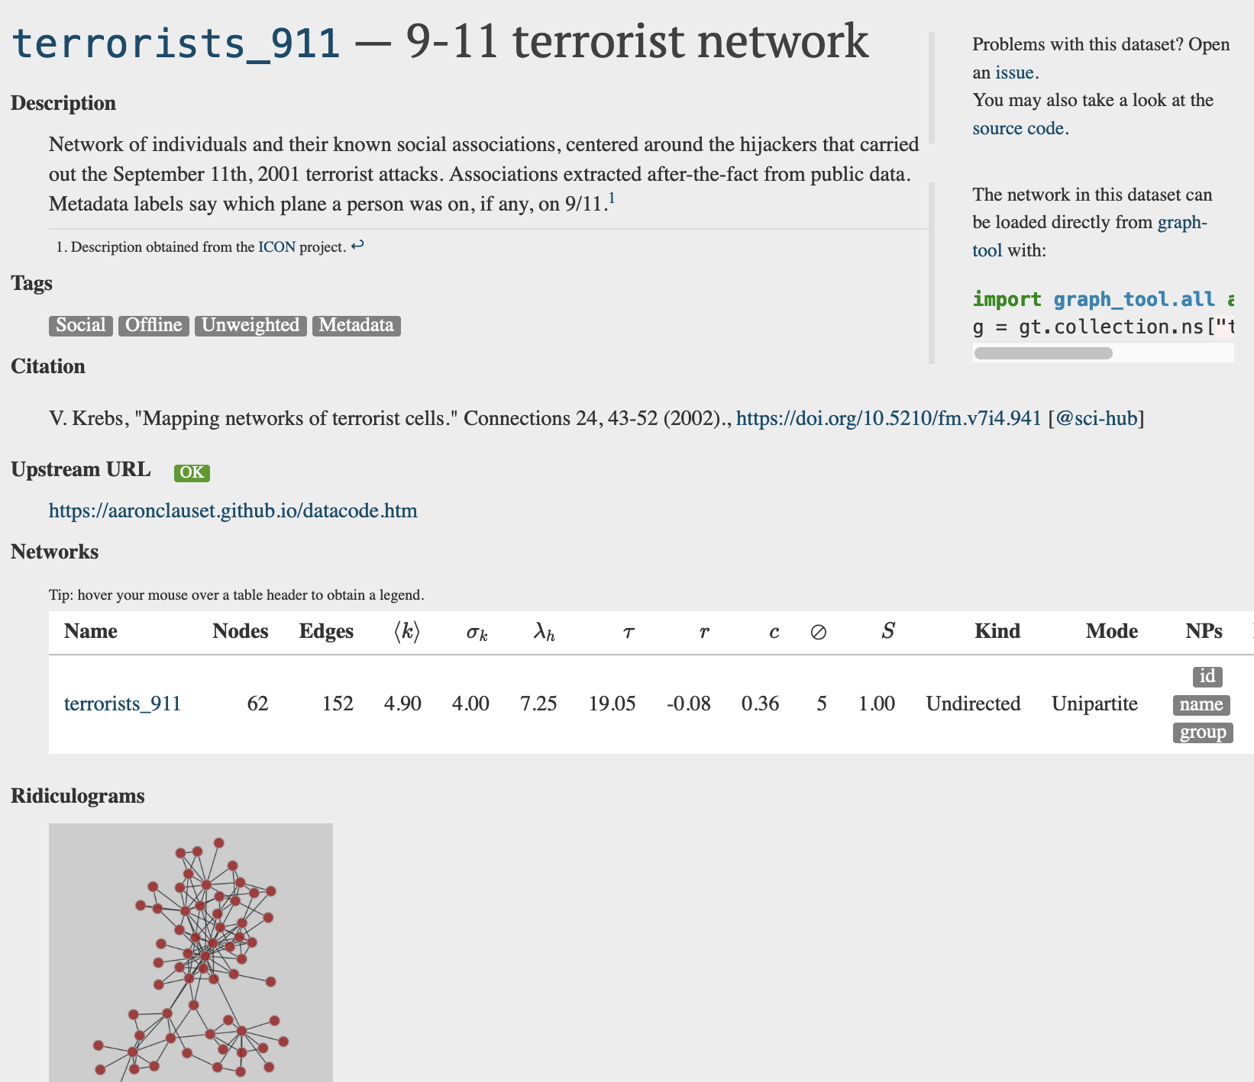
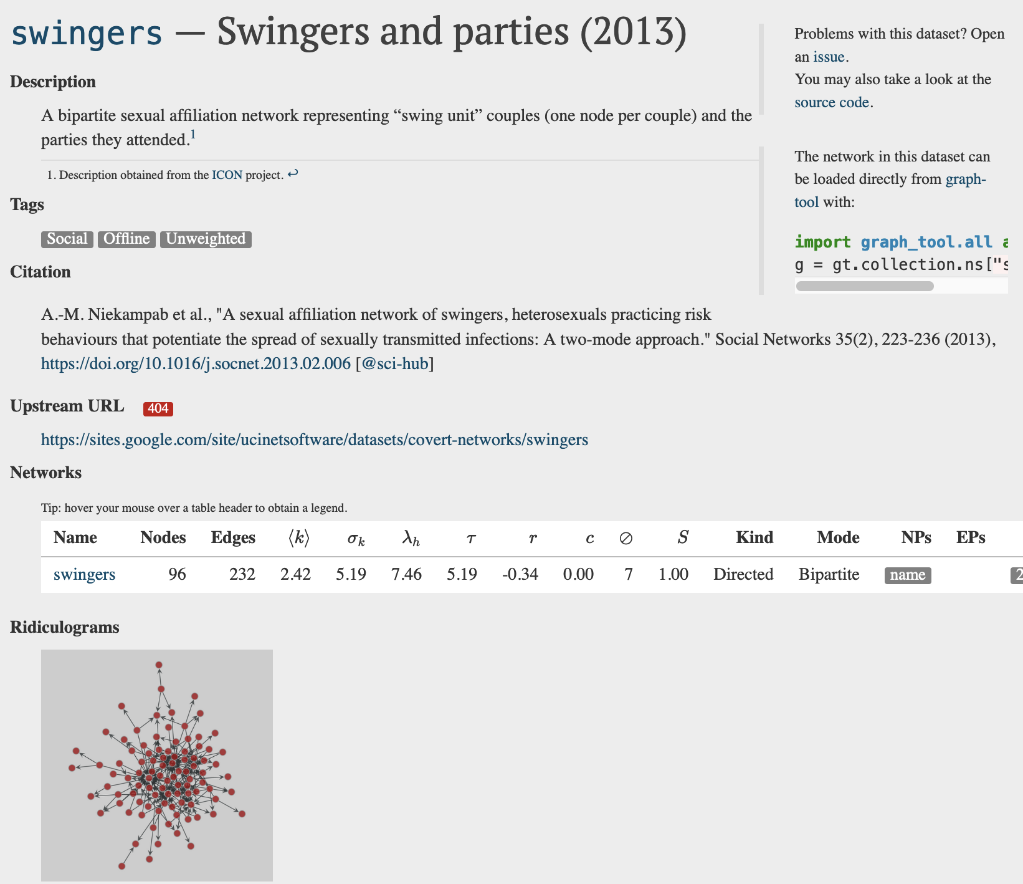
Network repository: networks.sweked.de

Slide 42
Affiliation networks at CBS

Slide 43
Bob
(100)
Available networks:
Work 1
Alice
(100)
School 1
John
(20)
How does the CBS newtorks look like?
Giant component → Most nodes are connected
Small world → Small diameter
Low density
Form cliques! (high clustering/transitivity)
Assortative (homophilic)
Heavy tail distributions
Work 2
School 2
Amy
(10)
Multipartite network

Slide 44
javier.science/panel_network

Slide 45
Types of analysis
They should fit your research question

Slide 46
Types of analysis: Descriptive statistics
Describe the network characteristics (density, diameter, average degree, clustering, etc)

Slide 47
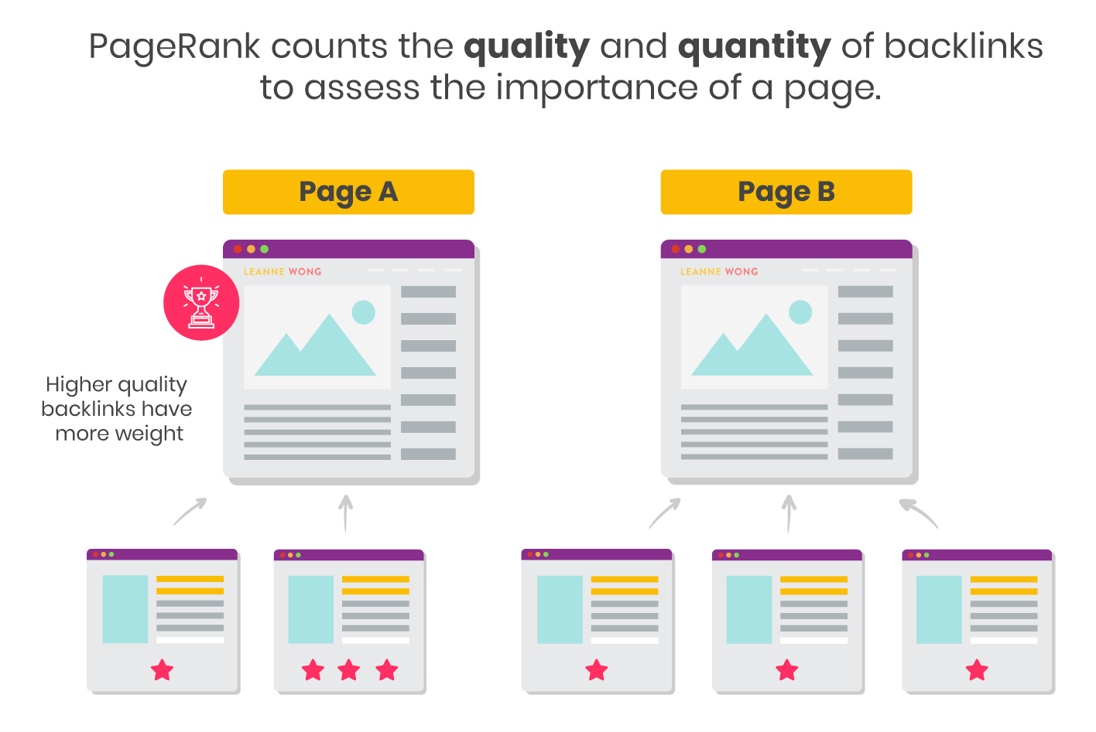
Types of analysis: Centrality
Who are the key actors in the network?
Centrality measures provide answers to this question.
How to stop the spread of diseases?
How to sort Google results?
https://www.leannewong.co/google-pagerank/
Important nodes: bridges
Important nodes: those linked by important nodes

Slide 48
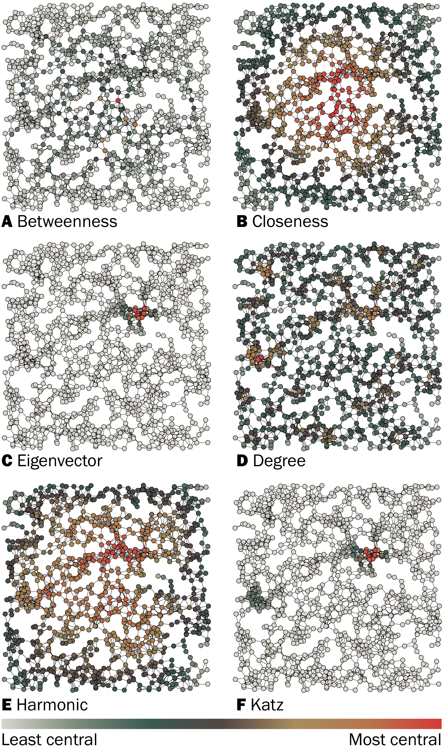
Centrality
Different centrality measures define importance in different ways :
Degree: Connected directly to many nodes
Closeness: Close to all other nodes (on average)
Betweenness: In the middle of many shortest paths
Pagerank/eigenvector/katz: Connected to important nodes
Centrality identify the most important nodes. It does not quantify the importance of nodes in general. The relative rankings of non-important nodes may be meaningless.
Pagerank

Slide 49
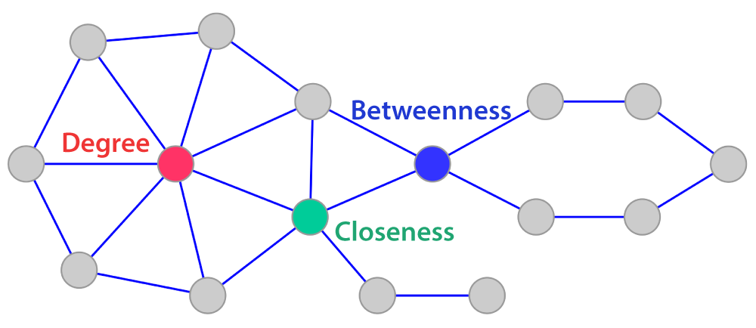
Which node has higher degree/betweenness/closeness?
Blue
Red
Green
https://cytoscape.org/cytoscape-tutorials/presentations/modules/network-analysis/index.html

Slide 50
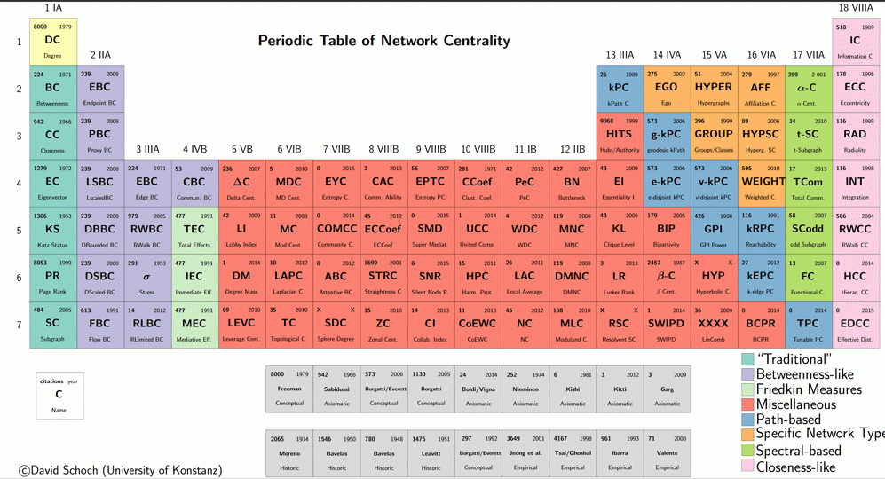
Use a centrality measure that fits your theory, not the one that gives you the best results
Consider what is the objective (e.g. is it to enable low-income individuals to increase their social capital?) (https://petterhol.me/2019/01/11/the-importance-of-being-earnest-about-node-importance/)

Slide 51
Types of analysis: Node-level regression
Calculate node-level features:
Centrality
Local clustering (transitivity / embeddedness)
Local reciprocity
Local assortativity (homophily)
…
Include in your model (e.g. a regression)

Slide 52
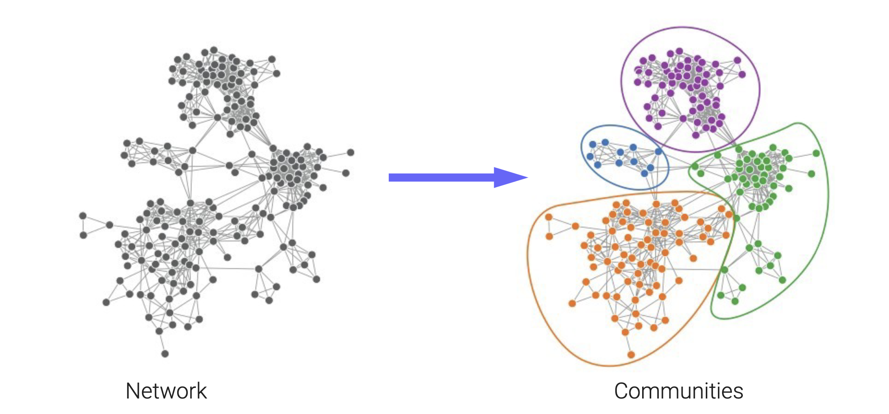
Types of analysis: Community detection
Image source: Leto Peel

Slide 53
Types of analysis: Community detection
Community detection = clustering on networks
It’s a type of unsupervised learning: We have the inputs (info on the nodes/edges), not the output (the community label)
We want to learn the outputs with a model.
The model uses some assumptions: nodes in the same community have the same type of connectivity pattern
e.g. there are many links within communities and few links across communities

Slide 54
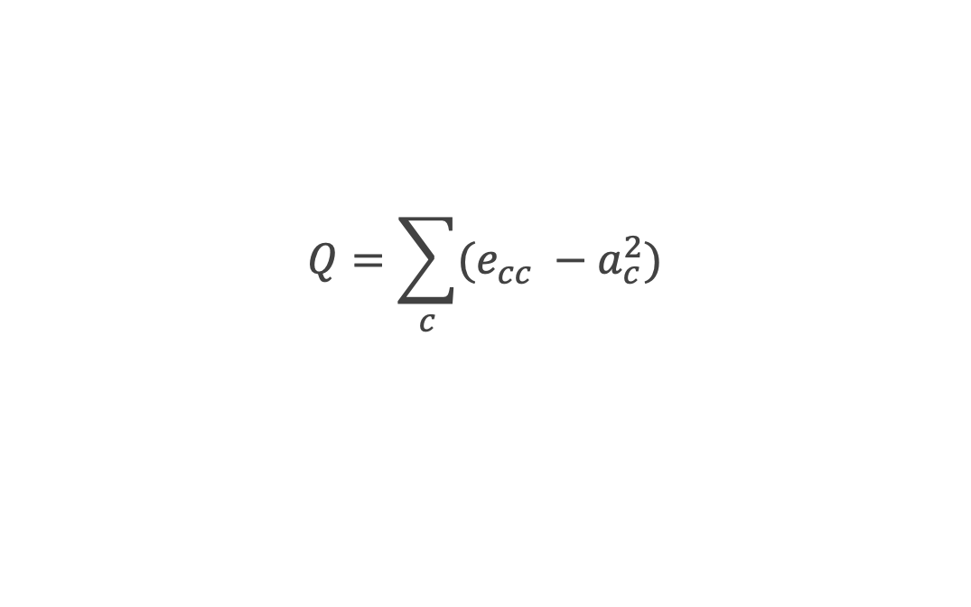
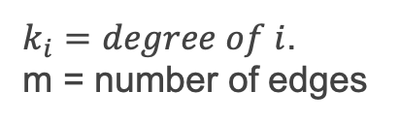
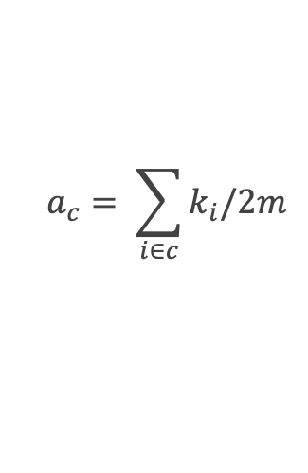
How to partition the network?
There are many algorithms to partition the network into communities
Often: the algorithms detect communities so that there are many links within communities and few links across communities
Main example: communities that maximize modularity (Q)
$$Q=\sum_{c}{(e_{cc}} −a_{c}^{2})$$
Fraction of links inside community c
Expected fraction of links within a community in a random network
$$a_{c}= \sum_{i∈c}{k_{i}/2m}$$
$k_{i}=degree of i$.
m = number of edges

Slide 55
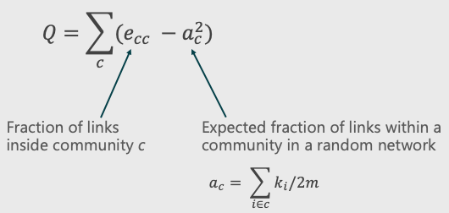
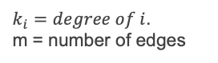
How to partition the network?
$k_{i}=degree of i$.
m = number of edges
 | e_{cc} | a_{c} | e_{cc} – a_{c}^2
c=Black | 4/12 | 10/24 | 0.160
c=Yellow | 3/12 | 7/24 | 0.165
c=Purple | 3/12 | 7/24 | 0.165
Modularity |  |  | 0.490
By Sohini6685 - Own work, CC BY-SA 3.0, https://commons.wikimedia.org/w/index.php?curid=17042821

Slide 56
How to partition the network?
$k_{i}=degree of i$.
m = number of edges
 | e_{cc} | a_{c} | e_{cc} – a_{c}^2
Black | 8/12 | 17/24 | 0.165
Purple | 3/12 | 7/24 | 0.165
Modularity |  |  | 0.310
By Sohini6685 - Own work, CC BY-SA 3.0, https://commons.wikimedia.org/w/index.php?curid=17042821

Slide 57
How to partition the network?
Algorithms for modularity maximization (and related methods)
Louvain and Leiden algorithms
Spinglass algorithm (penalize existing and non-existing links differently)
Other algorithms
Walktrap: Drop many “random walkers” in the network and see how often they visits pairs of nodes in the same walk.
Label propagation:
Each node is initialized with a unique label. Iteratively, each node adopts the label that most of its neighbors currently have.
We can add information on some pre-labelled nodes
Statistical inference: the Stochastic Block Model

Slide 58
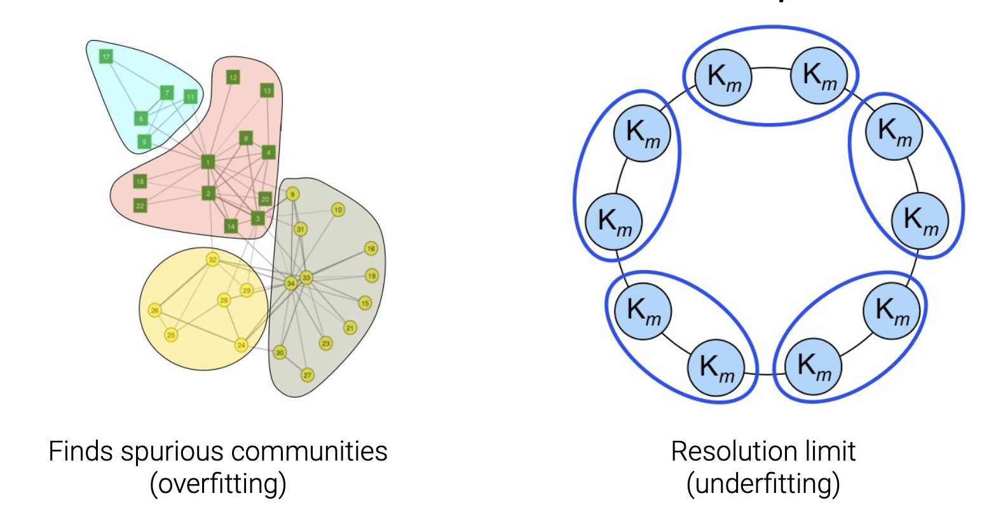
Problems with modularity maximization

Slide 59
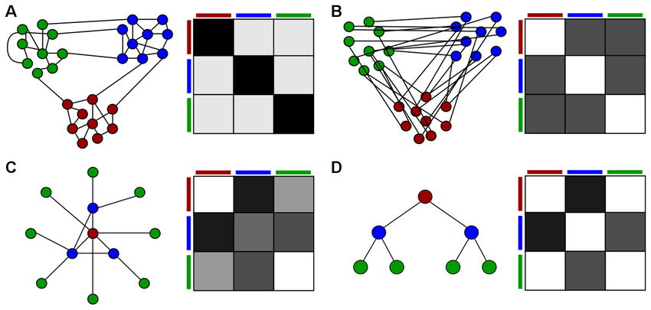
Stochastic Block Model (SBM)
Defines communities as unique connectivity patterns, represented in a block matrix.
Can find other connectivity patterns apart from the ones defined by modularity maximization (“many connections within communities, few between communities”)
But very complex!

Slide 60
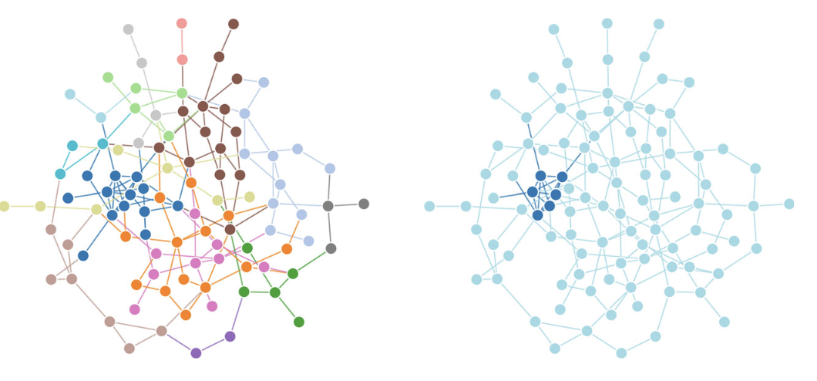
Modularity
SBM
Peel, L., Peixoto, T. P., & De Domenico, M. (2022). Statistical inference links data and theory in network science. Nature Communications, 13(1), 6794.

Slide 61
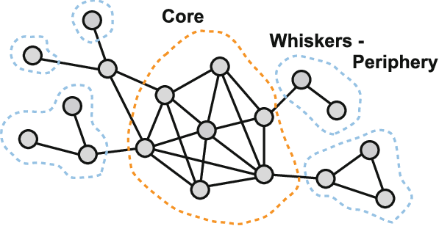
What communities would modularity maximization find in a core-periphery network? What about SBM?
(Leskovec et al. 2008)

Slide 62
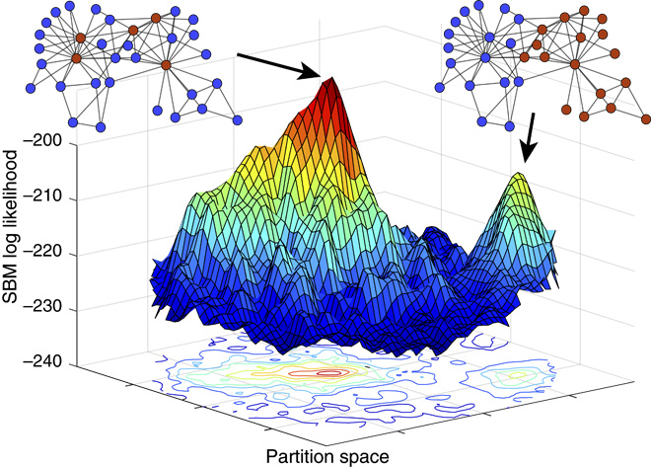
Many good partitions exist!
“It is standard practice to treat some observed discrete-valued node attributes, or metadata, as ground truth. We show that metadata are not the same as ground truth and that treating them as such induces severe theoretical and practical problems. We prove that no algorithm can uniquely solve community detection, and we prove a general No Free Lunch theorem for community detection, which implies that there can be no algorithm that is optimal for all possible community detection tasks” (Peel, Larremore, Clauset, 2017)

Slide 63
There may be many good ways to partition a network, some unrelated to the node attributes you have!

Slide 64
Some other type of analysis

Slide 65
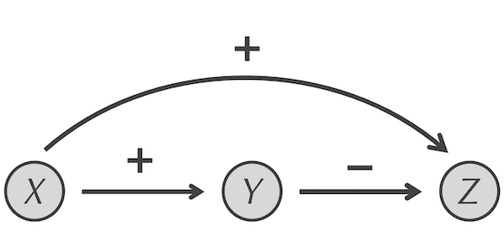
Types of analysis: Motif detection
Find overrepresented patterns
Feed-forward loop (https://biologicalmodeling.org/motifs/feedforward)

Slide 66
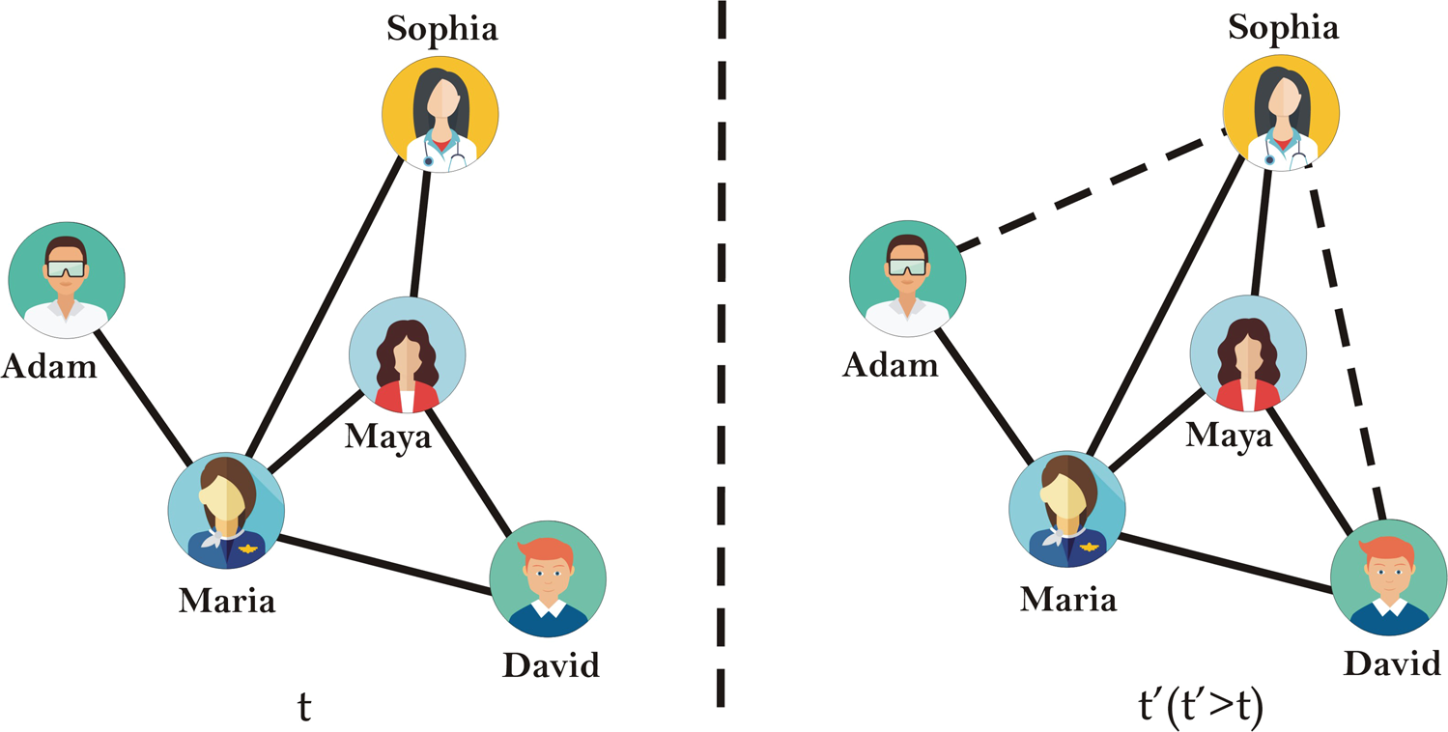
Types of analysis: Link/metadata prediction
Networks are rarely complete
Link prediction approach: Approaches such as triangle closure
Ahmad et al 2020

Slide 67
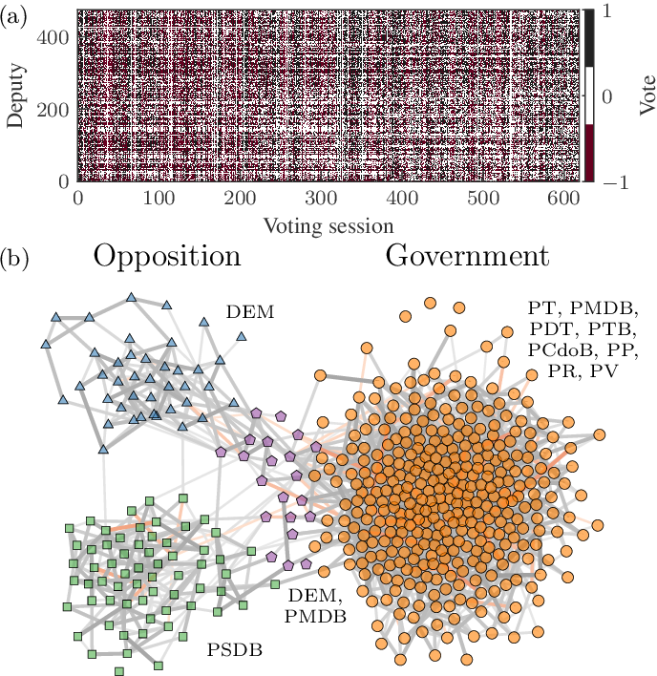
Types of analysis: Network reconstruction
Network from co-occurrences
Network Reconstruction and Community Detection from Dynamics, Peixoto 2019

Slide 68
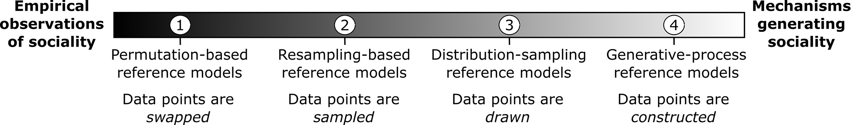
Types of analysis: Testing hypothesis
We observe some behavior in the network (e.g. the clustering is 0.5). Is this relevant?
Approach: Create a reference model (see Hobson 2021 for a great guide) to compare with it
- Configuration model (permuting edges)
- Generative models (e.g. rich get richer model)
- ERGM (which features of dyads affect the presence or strength of edges.)
- ABM
Hobson 2021

Slide 69
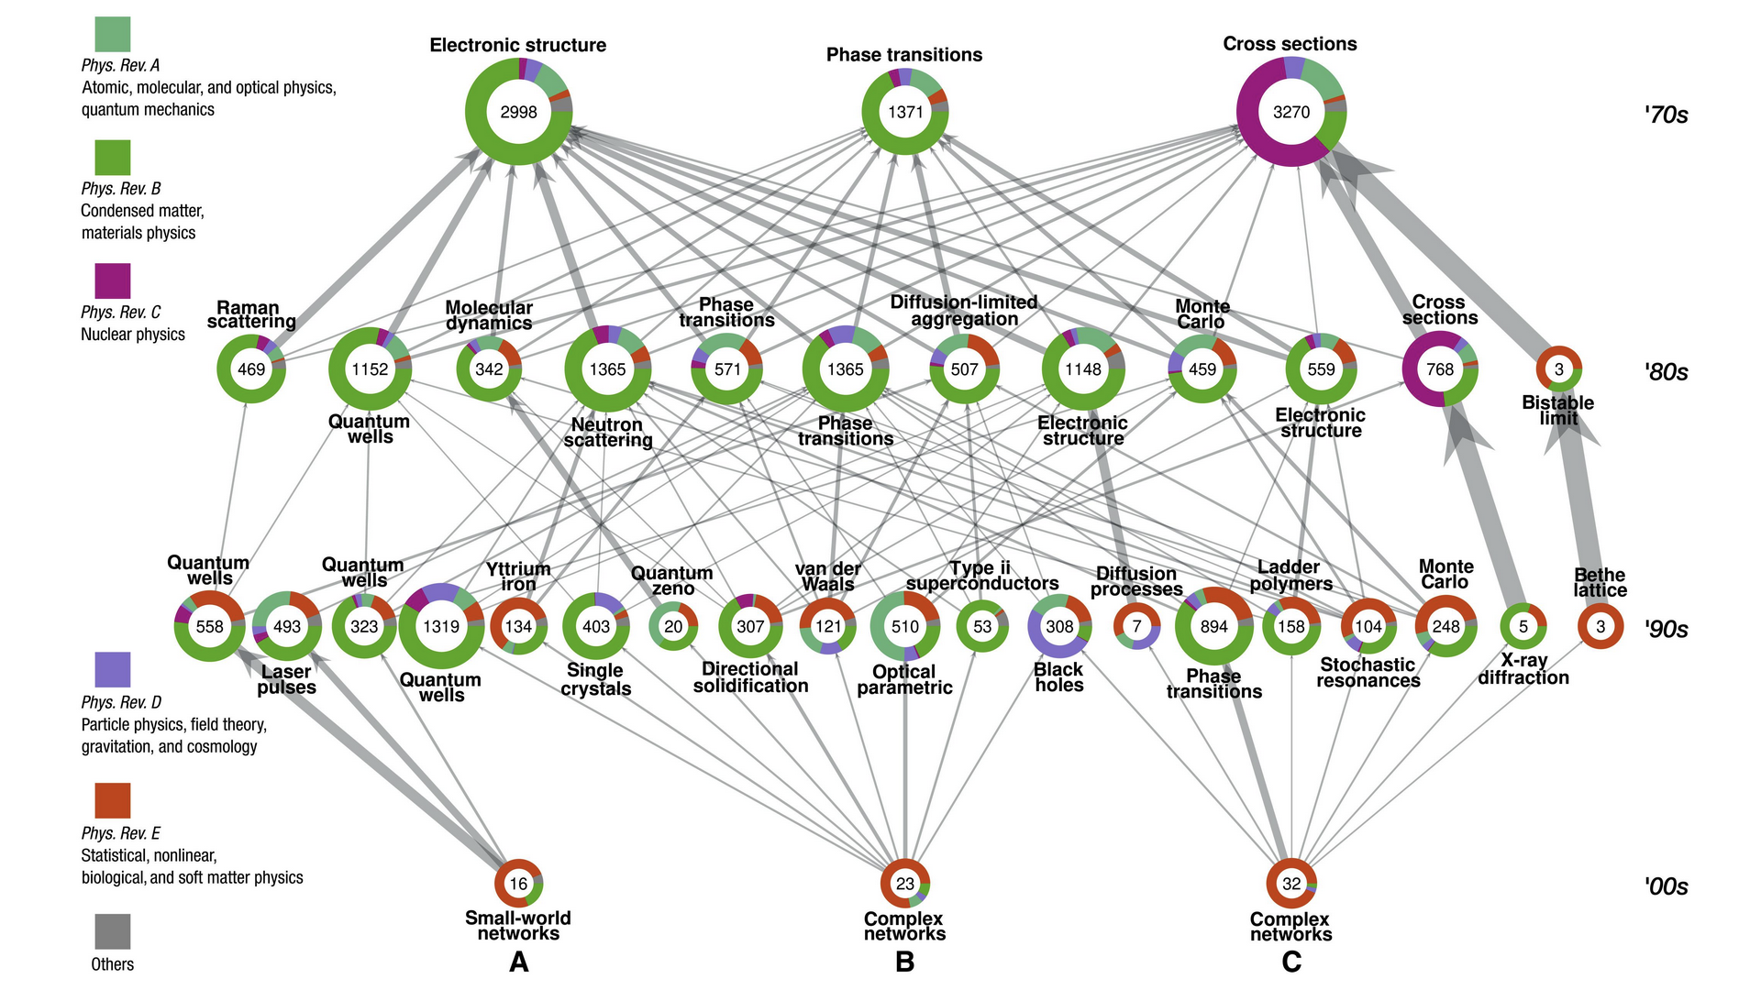
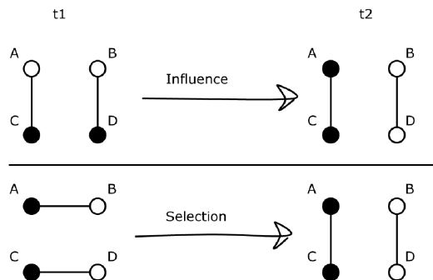
Types of analysis: Dynamics
How does behavior/diseases/information spread?
Allow to test selection vs influence
Run simulations on networks
Game theory
Epidemic spreading
Gene expression
Friemel, 2015
Bovet et al, 2022

Slide 70
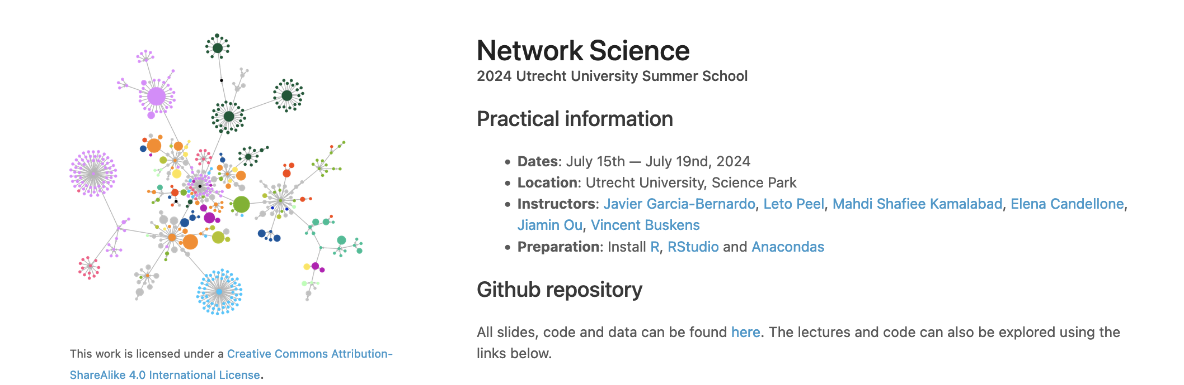
Want to learn more about networks?
Last practical, make sure to finish the first part
Next week: No lecture, EXAM on location

Slide 71
Networks at CBS (POPNET data)

Slide 72
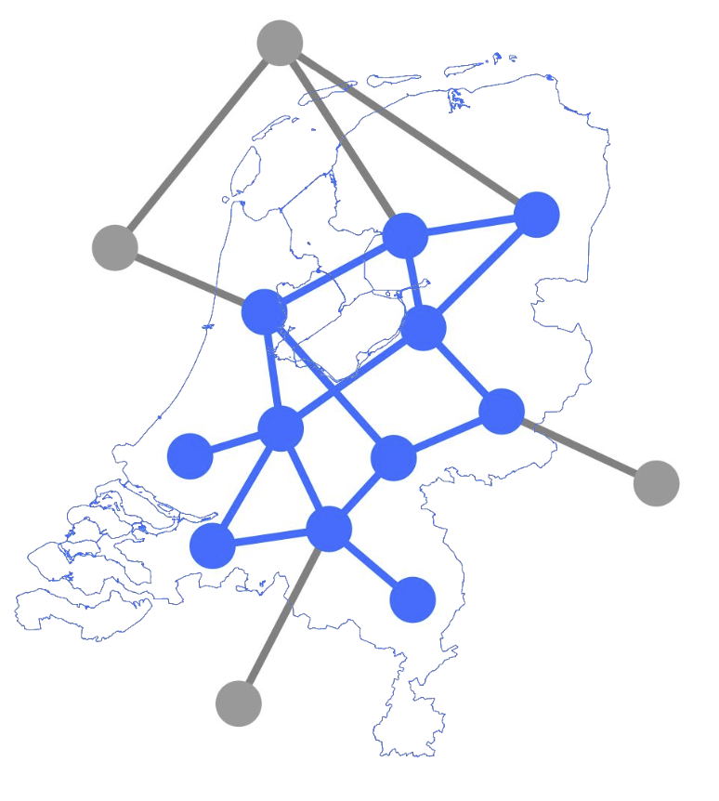
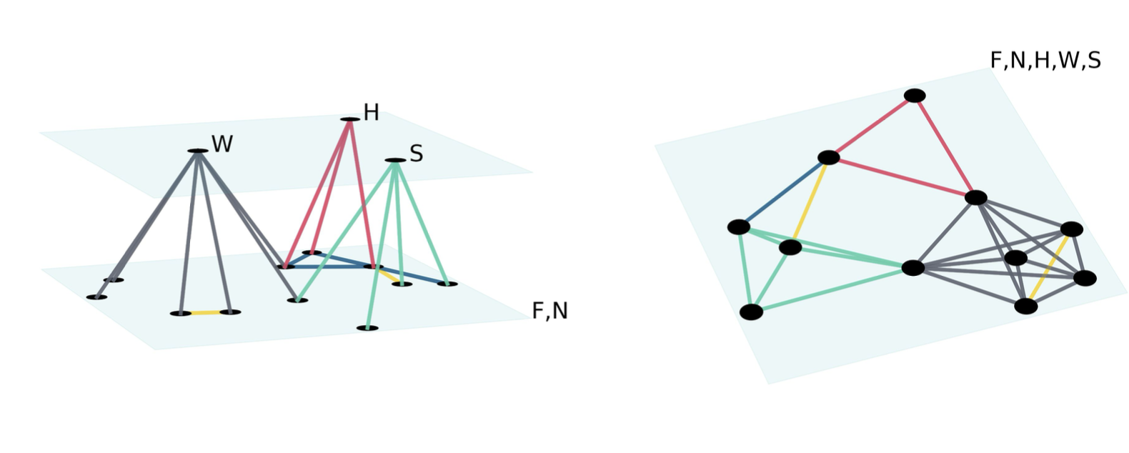
Every person in the Netherlands
Images: Eszter Bokányi (POPNET)
Kazmina et al, 2024

Slide 73
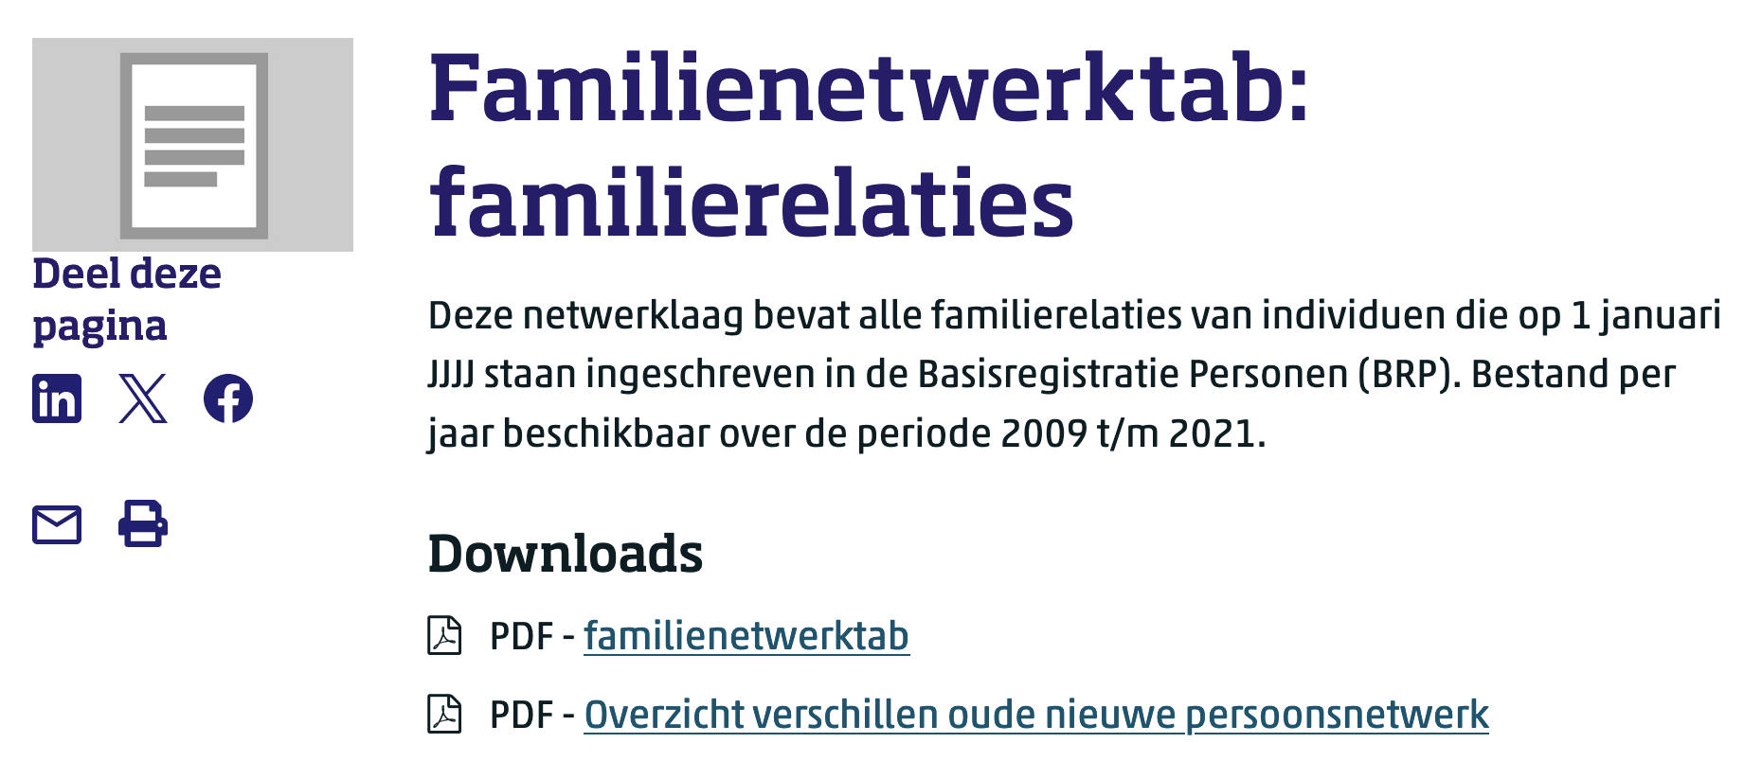
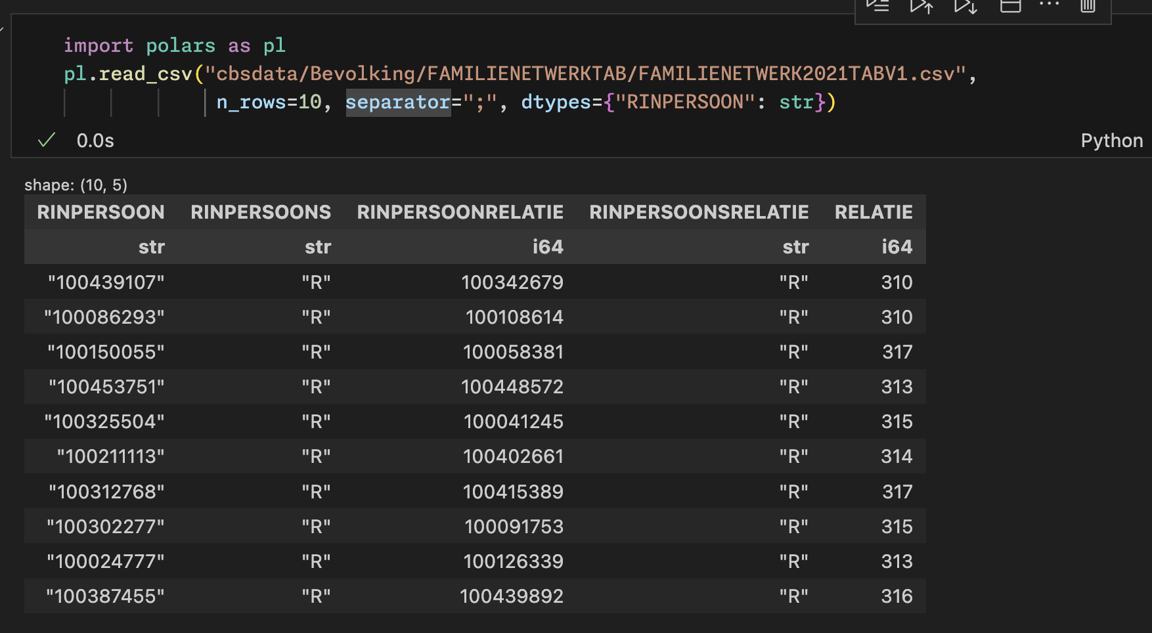
Data
317: 'Stepparent',
Child
Stepparent

Slide 74
"Neighbors": "BURENNETWERKTAB"
101: 'Neighbor - 10 closest addresses',
102: 'Neighborhood acquaintance - 20 random neighbors within 200 meters’,
"Colleagues": "COLLEGANETWERKTAB"
201: 'Colleague’,
"Housemates": "HUISGENOTENNETWERKTAB"
401: 'Housemate',
402: 'Housemate - institution’,
"Schoolmates": "KLASGENOTENNETWERKTAB"
501: 'Classmate primary education',
502: 'Classmate special education',
503: 'Classmate secondary education',
504: 'Classmate vocational education',
505: 'Classmate higher professional education',
506: 'Classmate university education'
"Family": "FAMILIENETWERKTAB"
301: 'Parent',
302: 'Co-parent',
303: 'Grandparent',
304: 'Child',
305: 'Grandchild',
306: 'Full sibling',
307: 'Half sibling',
308: 'Unknown sibling',
309: 'Full cousin',
310: 'Cousin',
311: 'Aunt/Uncle',
312: 'Partner - married',
313: 'Partner - not married',
314: 'Parent-in-law',
315: 'Child-in-law',
316: 'Sibling-in-law',
317: 'Stepparent',
318: 'Stepchild',
319: 'Stepsibling',
320: 'Married full cousin',
321: 'Married cousin',
322: 'Married aunt/uncle',

Slide 75
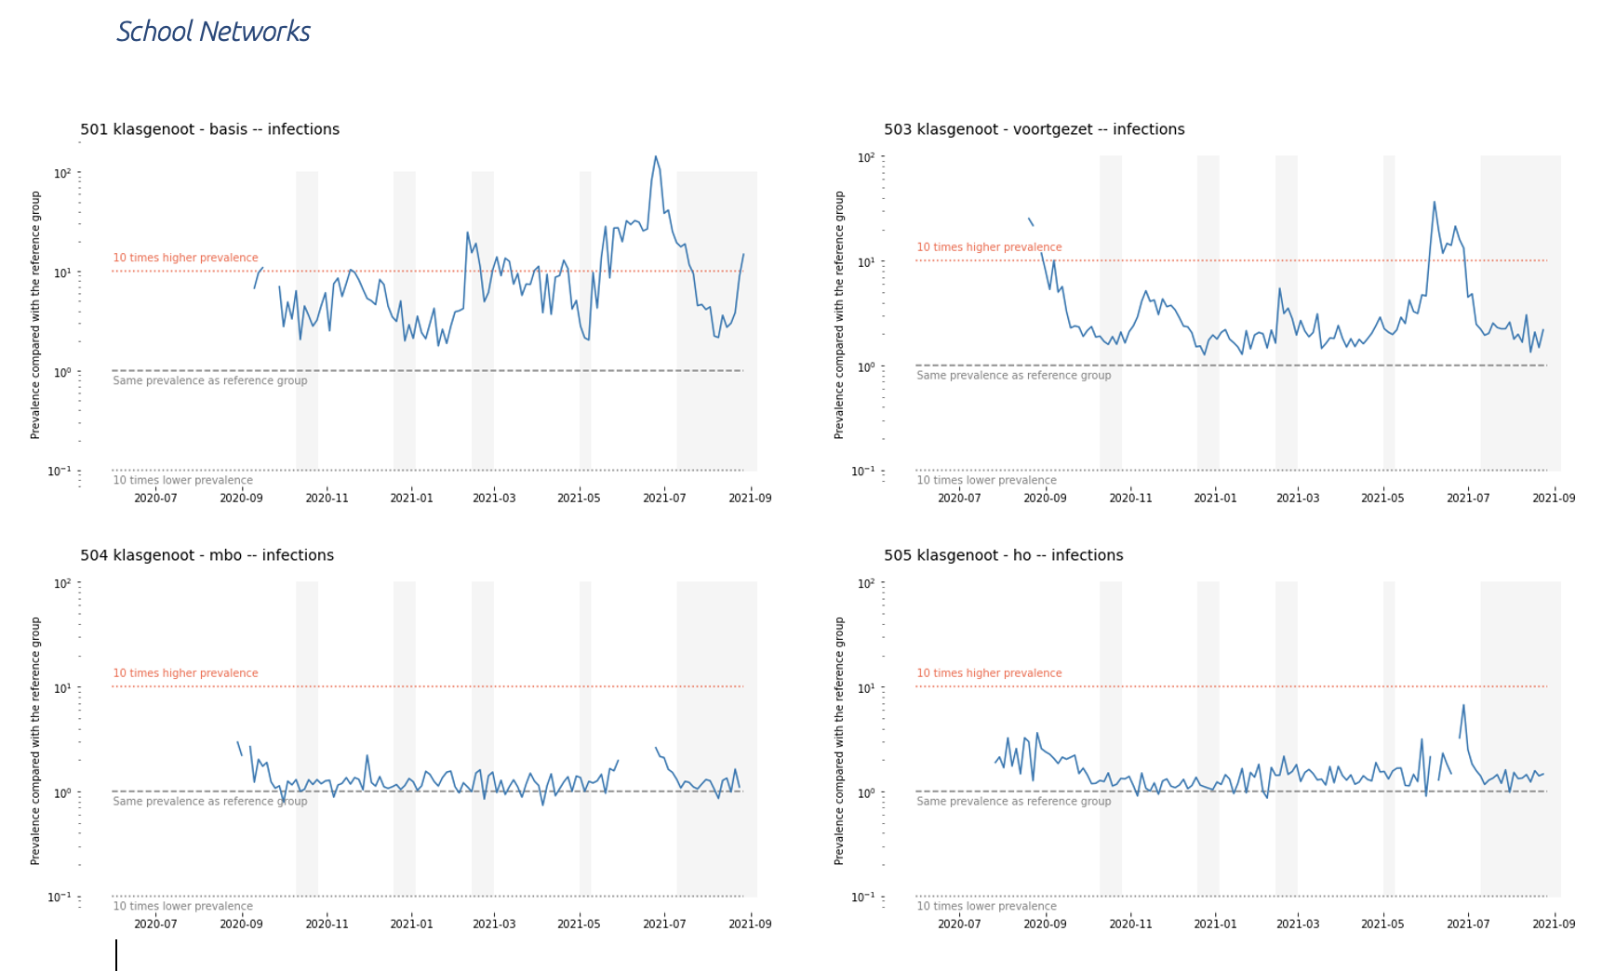
Not all network files are equally relevant

Slide 76
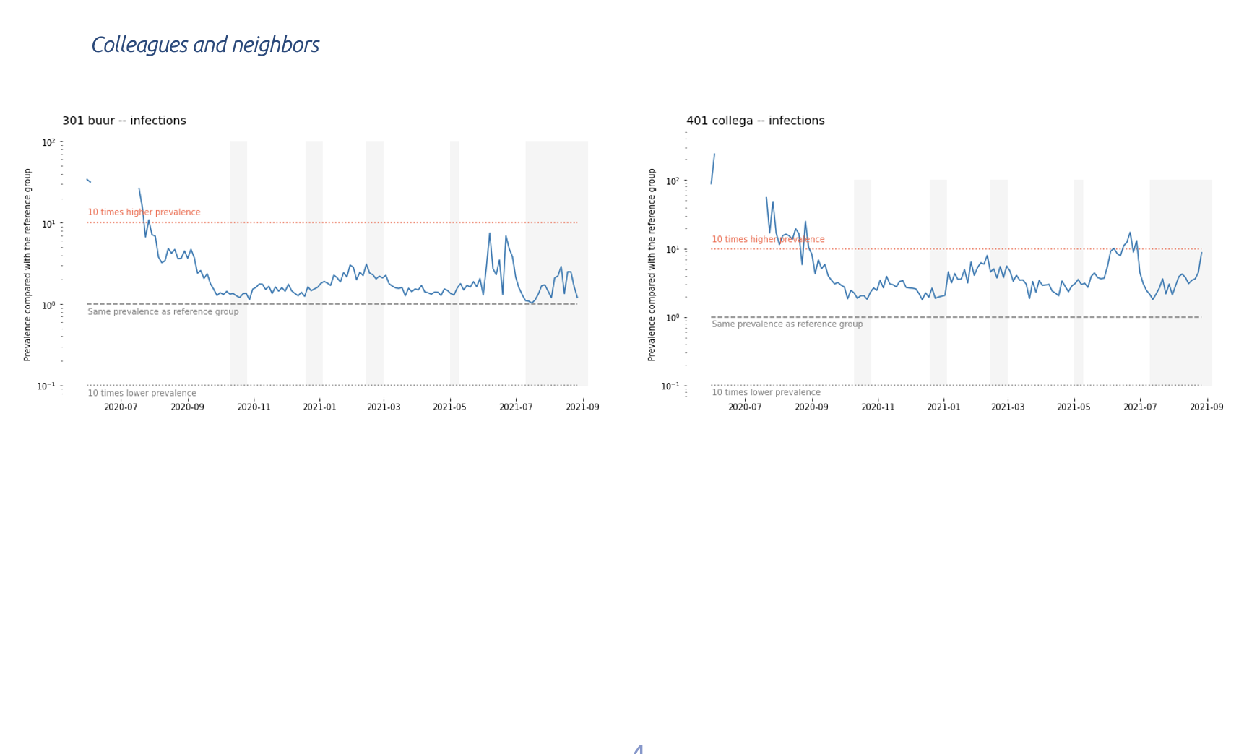

Slide 77
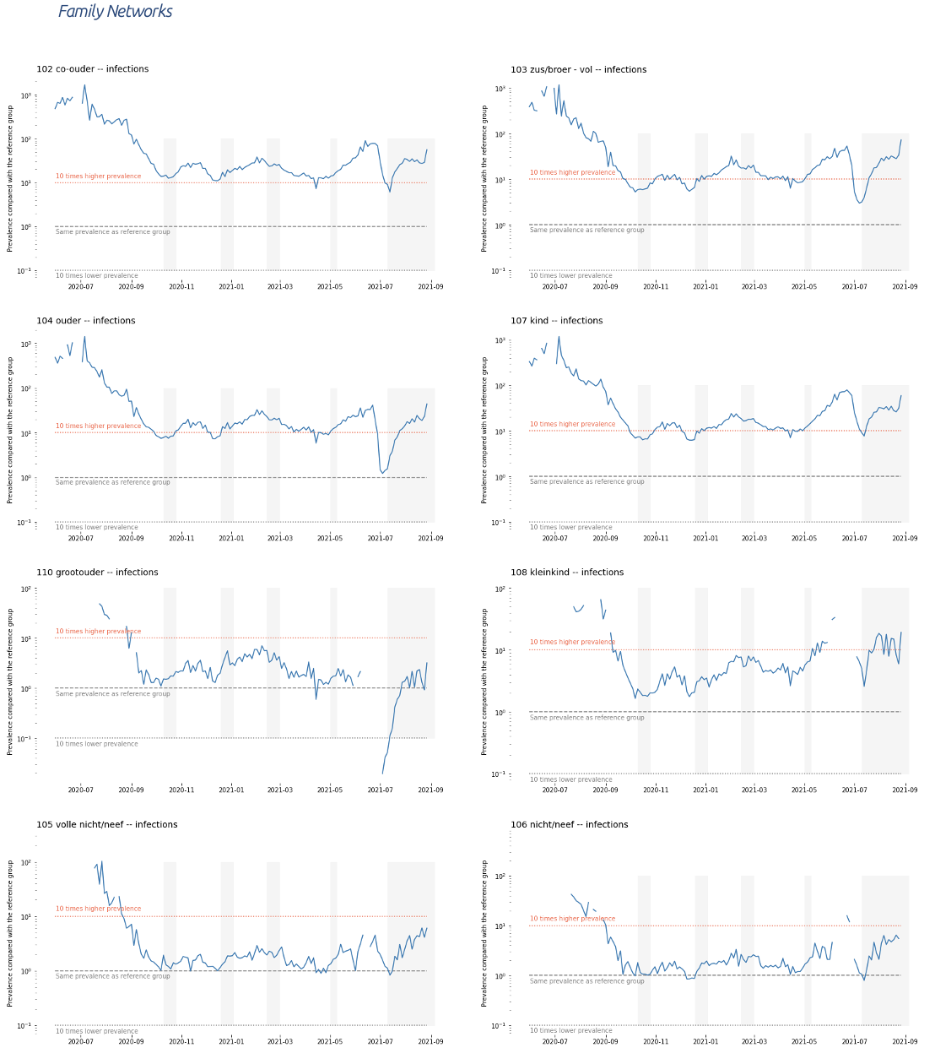

Slide 78
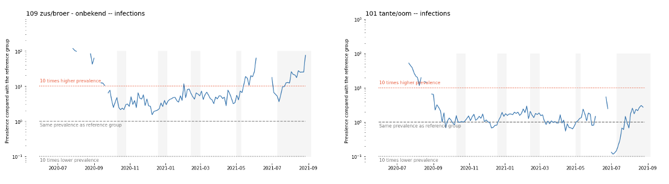

Slide 79
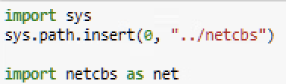
netCBS library (Python)
Allows you to create “network” queries, such as calculate the number of children of the siblings of the people in the sample
Library available at H:/netcbs
You can import it by adding the path to Python.
Supposing you are working in H:/group_x/pythonscript.ipynb

Slide 80
## How to construct the query
# 1. Start with the variables that you want to aggregate, e.g. "[Income, Age] ->"
# 2. Then add the relationships between the tables, e.g., "[Income, Age] -> Family[301]".
# In square brackets you can specify the type of the relationships:
# write [all] for all, or [301,302] for parents and co-parents
# 3. You can add several tables: "[Income, Age] -> Family[301] -> Schoolmates[all]"
# 4. Finally, you must write "-> Sample"
## Other parameters
# df_sample: A polars dataframe containing the sample (with the people you want to have information on)
# df_agg: A polars dataframe with the information you want to aggregate. For example, the income of all people in the country
# year: the year of the data you want to use
# agg_func: the aggregation functions you want to use. For example, [pl.mean or pl.sum]
# lazy: if True, the operations are concatenated lazily and computed at the end. If False, the operations are computed immediately
# Example
query = "[Income, Age] -> Family[301,302] -> Schoolmates[all] -> Sample"
df = netcbs.transform(query,
df_sample = df_sample,
df_agg = df_agg,
year=2021,
agg_func=[pl.mean, pl.sum, pl.max],
lazy=True
)

Slide 81
In general:
These are huge files!
There are 700 M colleagues, 415 M neighbors, 440 M housemates, 88 M cousins
Tips:
Start with small samples until you know everything works
Be efficient
Use polars instead of pandas
Use lazy operations
Clean up regularly using magic commands (remove data that you are not using from memory)
%reset_selective –f df_x3
The RA will crash
Save your results to the hard drive using efficient data structures (pl.write_parquet)

Slide 82
H:/network_examples/exercice.ipybn
Copy the file to your group folder
Please only one person per group! (heavy server)
Keep the queries simple, otherwise they will take too long

